Slide 1
New Mexico State 4-H Conference Contest Scan-Trons
Revised 2025
Contests:
Horse
Livestock
Consumer Decision Making
Meats
Entomology
Horticulture
FCS Skill-a-thon
Agronomy
Pasture & Range
Land Judging
Meats
Livestock Skill-a-thon
Livestock Judging
Dairy

Slide 2
County Codes
Each County is identified by a specific code that must be entered on all scan-trons. Youth enter the code in the section marked Chapter, County or Club Number.
If a County has more than one team in any contest, they will be assigned a prefix number to designate the second Team. For example, Eddy County First Team will be 0409, Eddy County Second Team will be 1409.
County Codes are listed on the next slide. Your County number is the same for every event/contest!

Slide 3
County Codes (Continued)
Bernalillo | 0401
Catron | 0402
Chaves | 0403
Cibola | 0404
Colfax | 0405
Curry | 0406
De Baca | 0407
Dona Ana | 0408
Eddy | 0409
Grant | 0410
Guadalupe | 0411
Harding | 0412
Hidalgo | 0413
Lea | 0414
Lincoln | 0415
Los Alamos | 0416
Luna | 0417
McKinley | 0418
Mora | 0419
Otero | 0420
Quay | 0421
Rio Arriba | 0422
Roosevelt | 0423
San Juan | 0424
San Miguel | 0425
Sandoval | 0426
Santa Fe | 0427
Sierra | 0428
Socorro | 0429
Taos | 0430
Torrance | 0431
Union | 0432
Valencia | 0433
All sections require members to bubble in the information for the computer to read it . Marks must be complete, dark and in pencil.

Slide 4
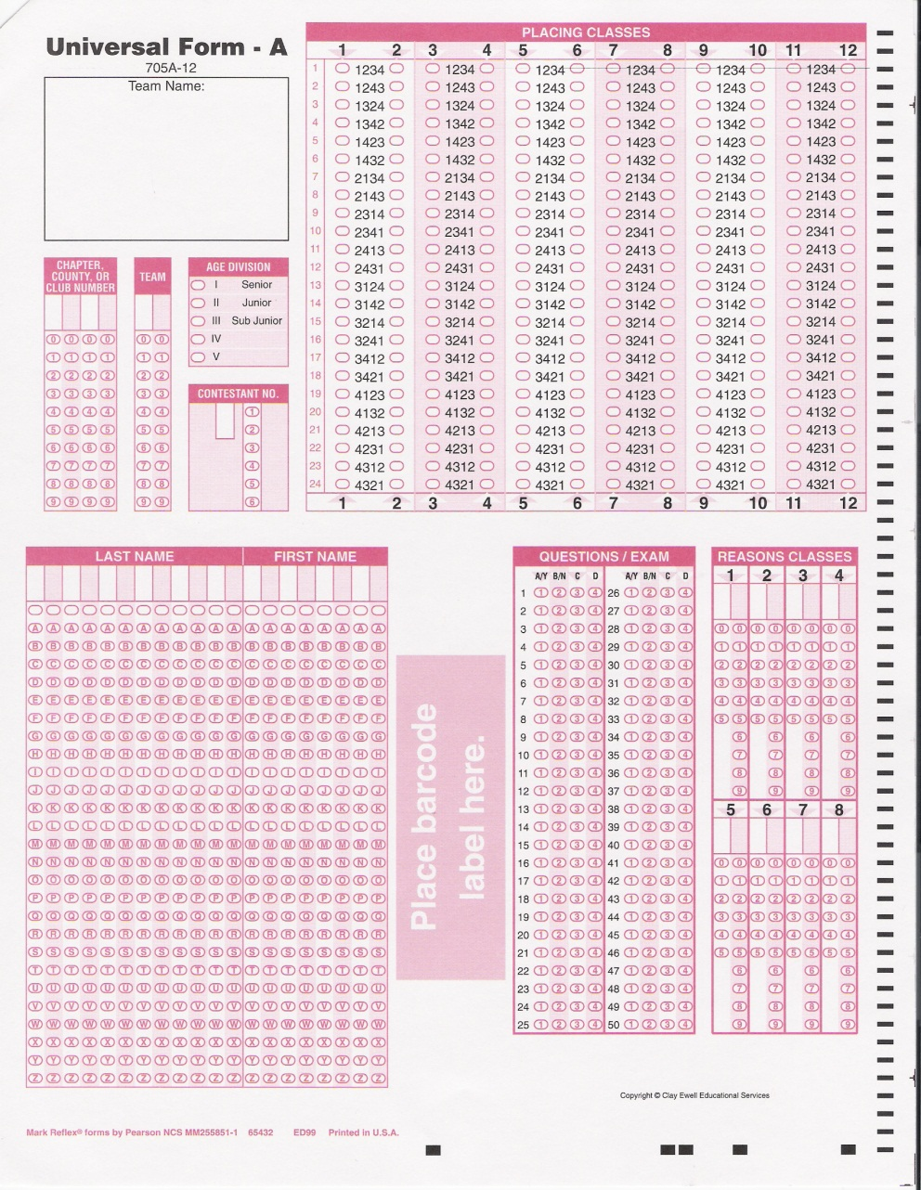
Horse Judging Consumer Decision Making Universal Form A – 705A-12
Class Placings
Name, County & Contestant #
Reasons Scores

Slide 5
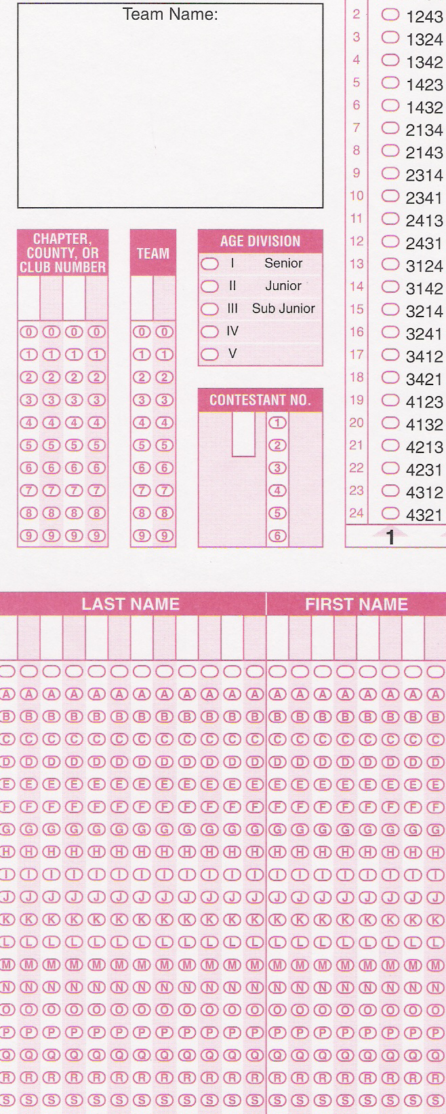
Horse & CDM Contests (cont)
Write in Name County and Contest for verification
Write in County Code and bubble in correct numbers.
X
DO NOT mark in the sections for Age or Contestant Number.
Team refers to the member’s position on the team. Write in the number that corresponds to position number and bubble it in.
1=01
2=02
3=03
4=04
X
The bubbles with no letters represent spaces or hyphens within a name.
Each contestant must write in their name – first and last – then bubble in the letters.

Slide 6
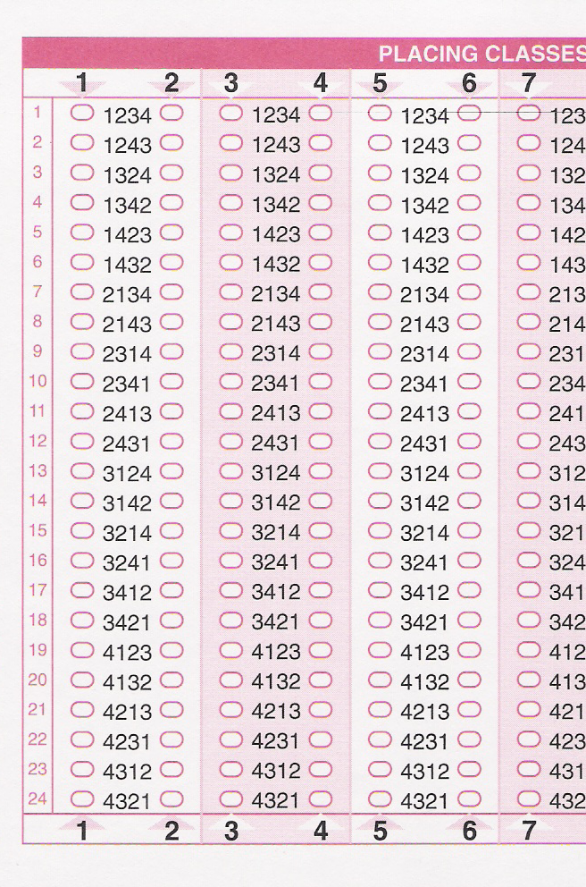
Horse & CDM (cont) Class Placings
To record their placings for a class, each contestant must bubble in the placing that corresponds to their answer in the Placing Classes Section
Remind them to double check that they are marking the correct class number for the class they are looking at.
For Example: They are judging Class #3. They have decided to place the class 2413. They would bubble in this bubble.
The Reasons Score Section will be completed by the Judges – DO NOT Mark in the Reasons Section.

Slide 7
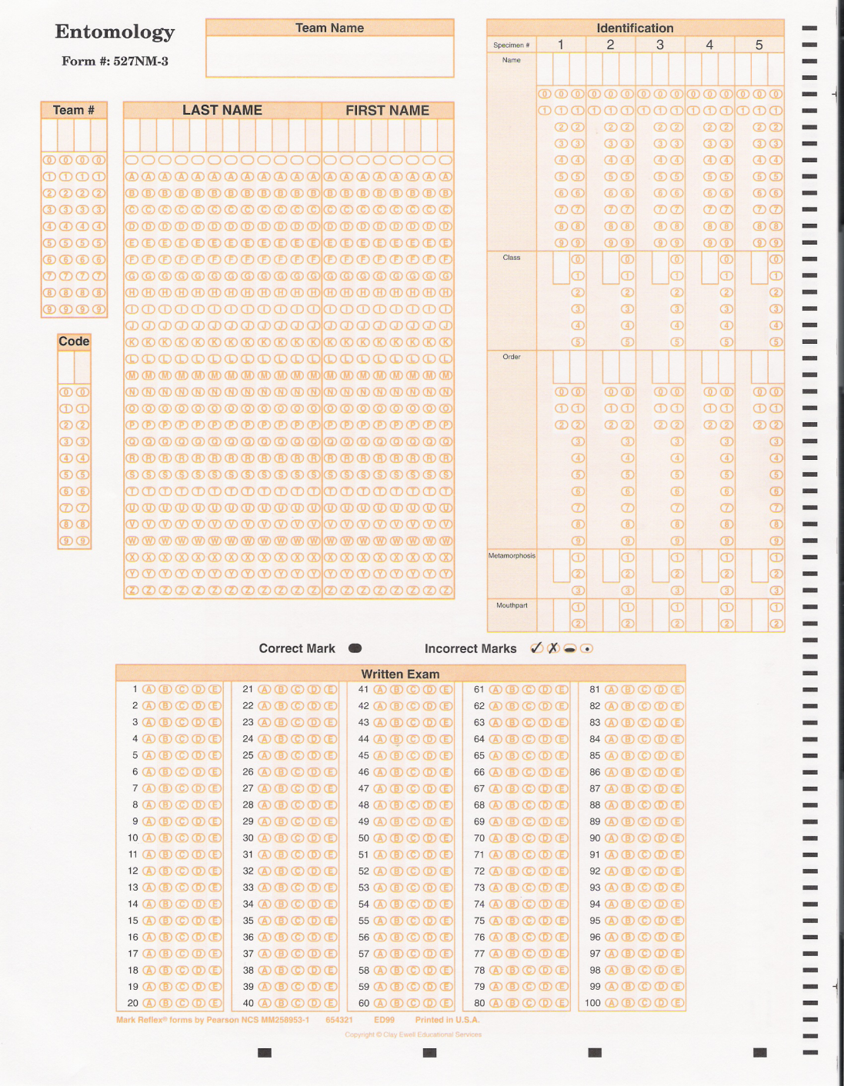
Entomology Form # 527NM-3
Name & County
County Code
Contestant Number (Team position number)
1=01
2=02
3=03
4=04
Name, First & Last
ALL MUST BE BUBBLED IN!
ID 1-5 are on the front of the sheet – the ID section is continued on the back of the form.
Contestants will complete the written exam in this section.

Slide 8
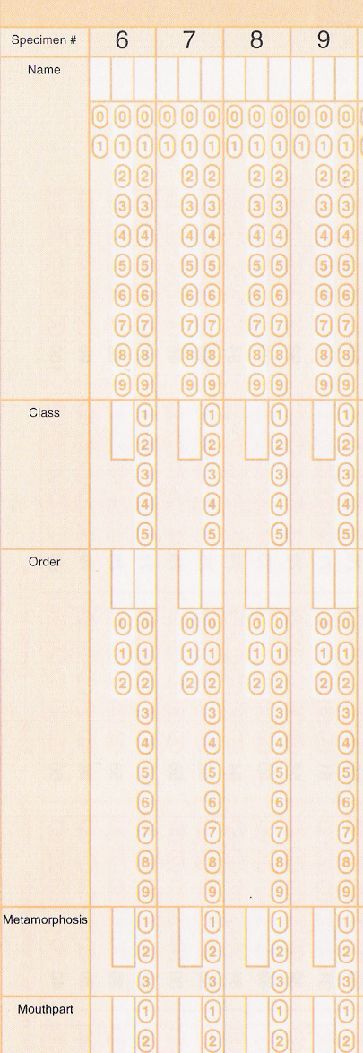
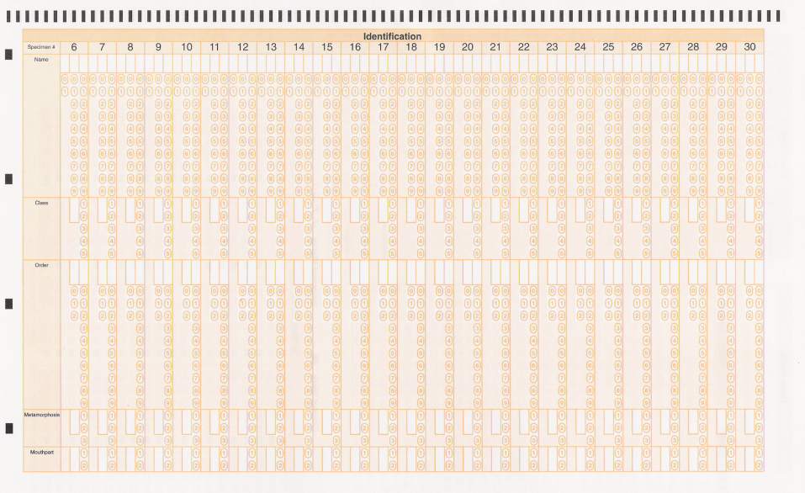
Entomology (continued)
Specimen # - Remind youth to double check they are marking the specimens on the correct #.
Find the specimen name on the supplied list and mark the scan-tron with the corresponding number. Contestants will then mark the corresponding number for the correct:
Class
Order
Metamorphosis
Mouthpart
Continued ID Section

Slide 9
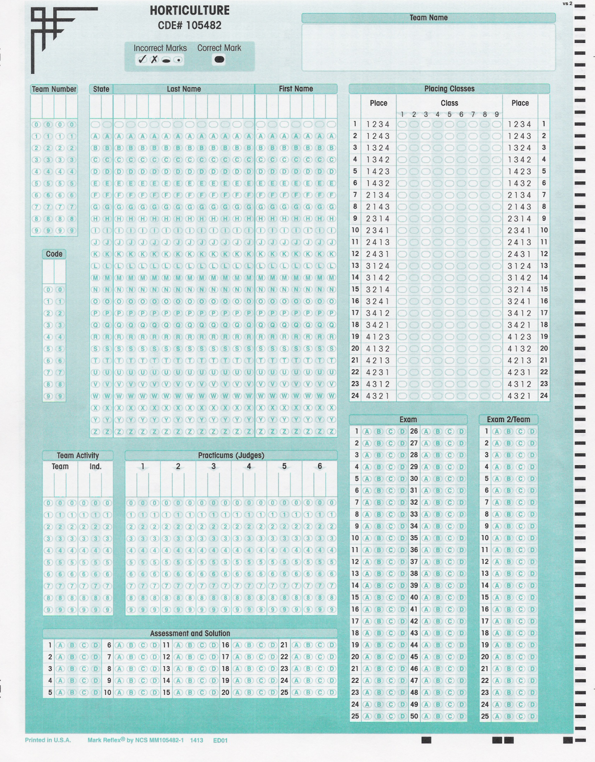
Horticulture FCS Skill-A-Thon Agronomy CDE# 105482
Name, County & Contest
County Code
Contestant Number (Team Position Number)
1=01
2=02
3=03
4=04
Name, First & Last
ALL MUST BE BUBBLED IN!
Remind Contestants to designate if this is for Horticulture, FCS Skill-a-thon or Agronomy
Class placings should be marked here. See slide 6 for a detailed view.
Contestants will complete the written exam in this section.

Slide 10
Horticulture FCS Skill-A-Thon Agronomy (continued)
For FCS Skill-a-thon, Financial Management will be completed here.
This section is completed by the judges if needed. DO NOT MARK in these sections.
X
X
Agronomy will use this section.

Slide 11
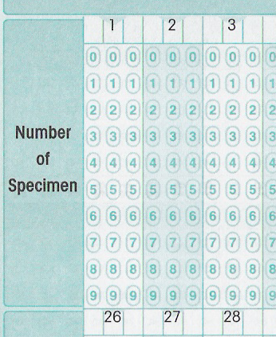
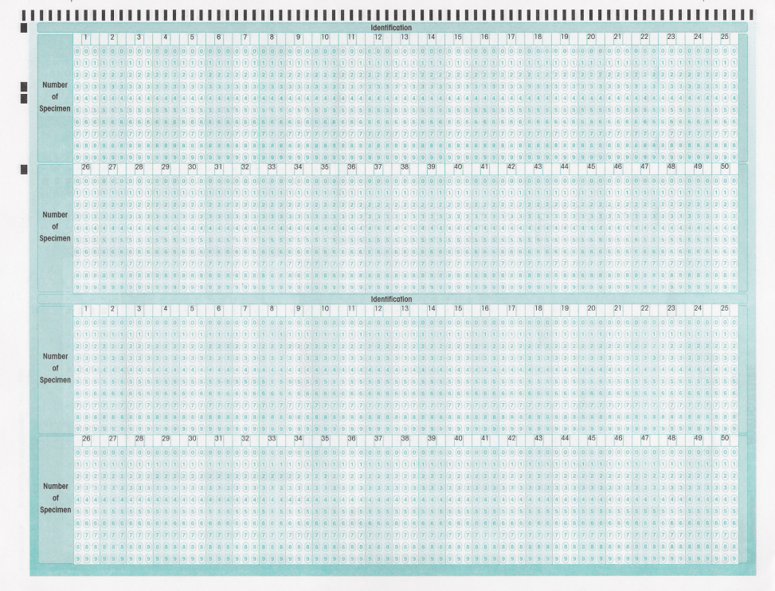
Horticulture FCS Skill-A-Thon Agronomy CDE# 105482
Specimen/Item # - Remind youth to double check they are marking the specimens on the correct #.
ID Section on the back of form.
Find the specimen/item name on the supplied list and mark the scan-tron with the corresponding number.

Slide 12
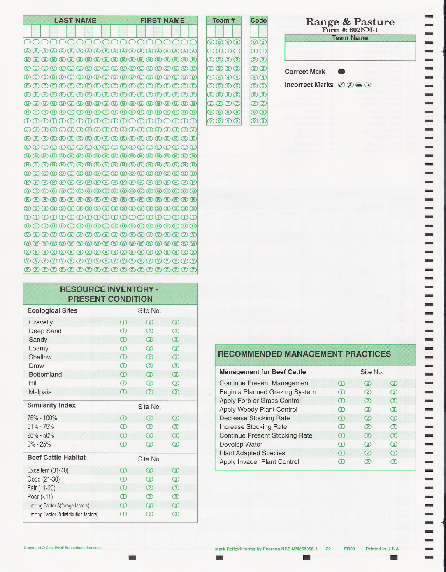
Pasture & Range Form # 602NM-1
Name & County
For each condition and/or practice bubble in the number of the field it applies to. Some rows may have multiple bubbles, some may have none, depending on the condition of each field. Remember that each field has it’s own column. And in some cases may have only one condition per section. Refer to the appropriate study guides to find out how to complete this section.
Name: Last, First
County Code
Contestant Number (Team Position)
1=01
2=02
3=03
4=04
ALL MUST BE BUBBLED IN!

Slide 13
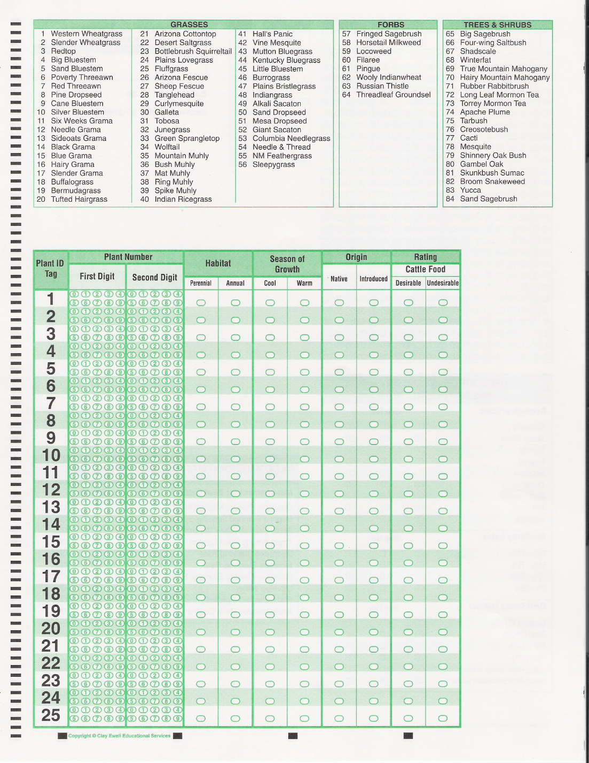
Pasture & Range (continued)
Identification List
Specimen # - Remind youth to double check they are marking the specimens on the correct #.
Contestants will mark the corresponding number for the correct:
Habitat
Season of Growth
Origin
Rating
Find the specimen name on the above list and mark the scan-tron with the corresponding number.

Slide 14
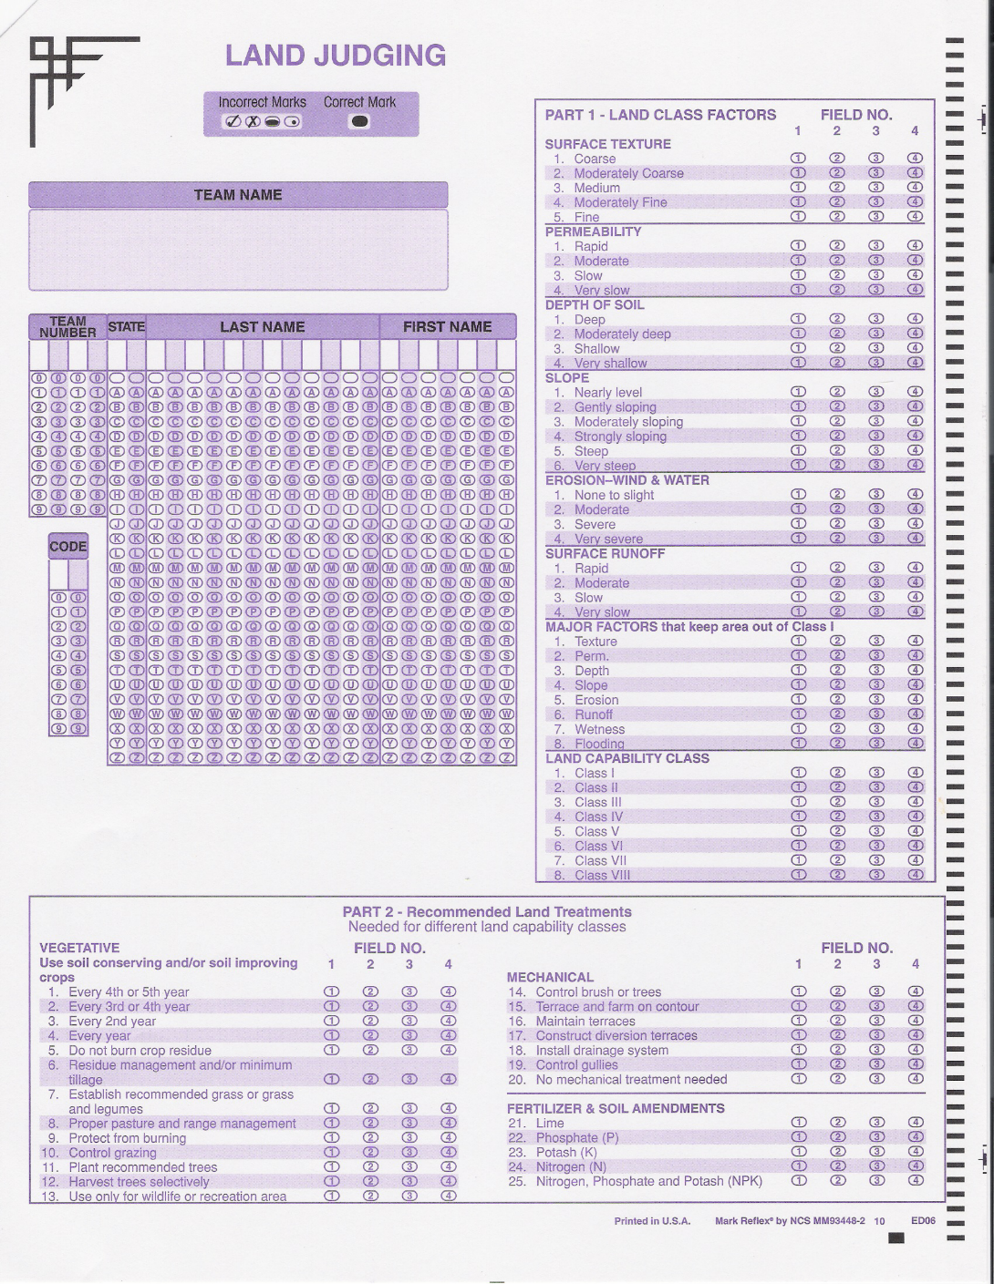
Land Judging
Field # - Remind youth to double check that they are marking for the correct field.
Name, County & Contest
For each factor and/or treatment bubble in the number of the field it applies to. Some rows may have multiple bubbles, some may have none, depending on the condition of each field. Remember that each field has it’s own column. And in some cases may have only one factor per section. Refer to the appropriate study guides to find out how to complete this section.
County Code
Contestant Number (Team Position)
1=01
2=02
3=03
4=04
Name, First & Last
ALL MUST BE BUBBLED IN!
#25 represents NONE – no fertilization needed.

Slide 15
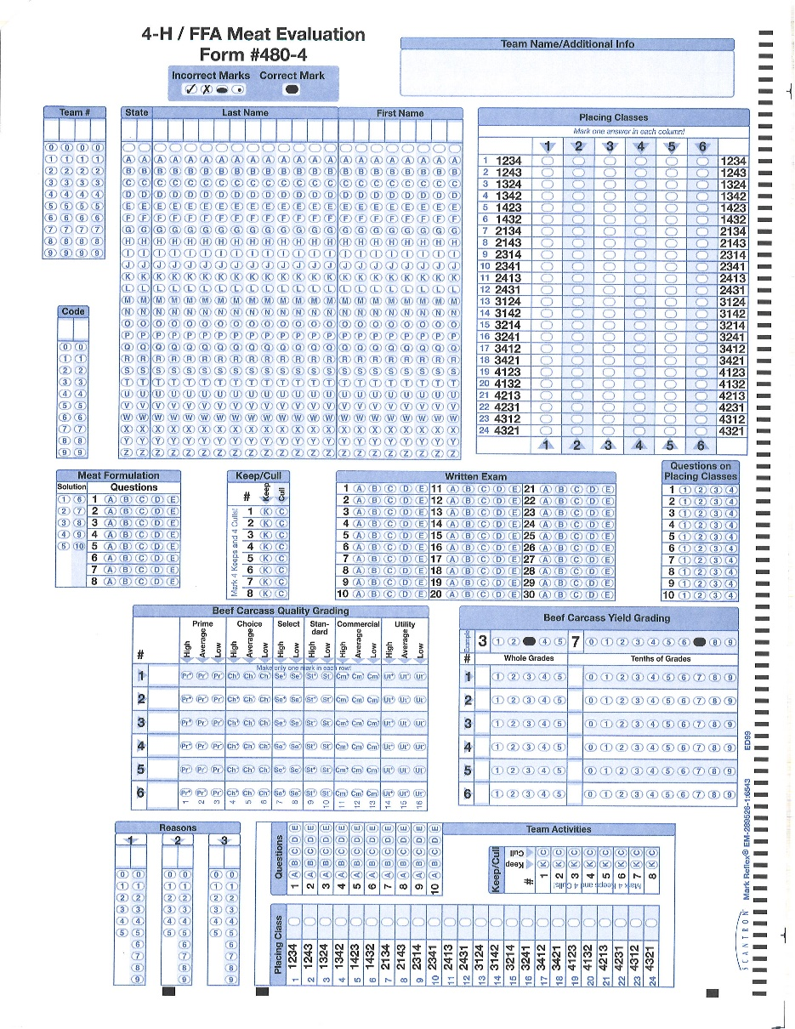
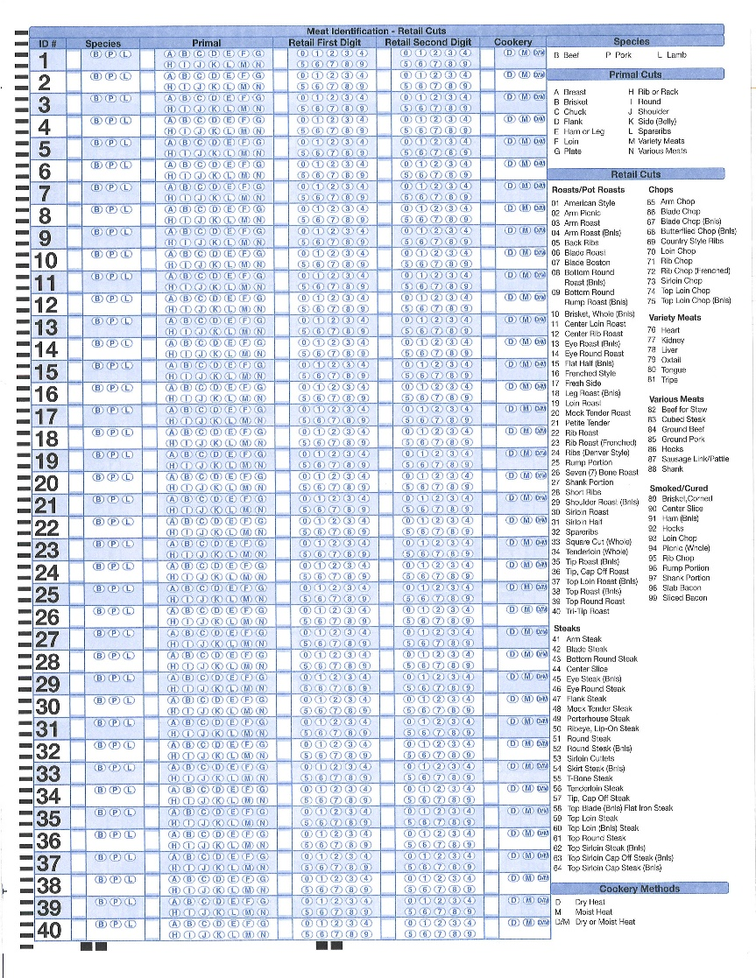
Meats Identification Livestock Skillathon* Form #480-4
Backside = ID Specimen/Item # - Remind youth to double check they are marking the specimens on the correct #.
Class Placings
Name, First & Last
County Code
Contestant Number (Team Position)
1=01
2=02
3=03
4=04
ALL MUST BE BUBBLED IN!
Reasons Scores
*If additional sections are needed for Skillathon, contestants will be notified at the contest.

Slide 16
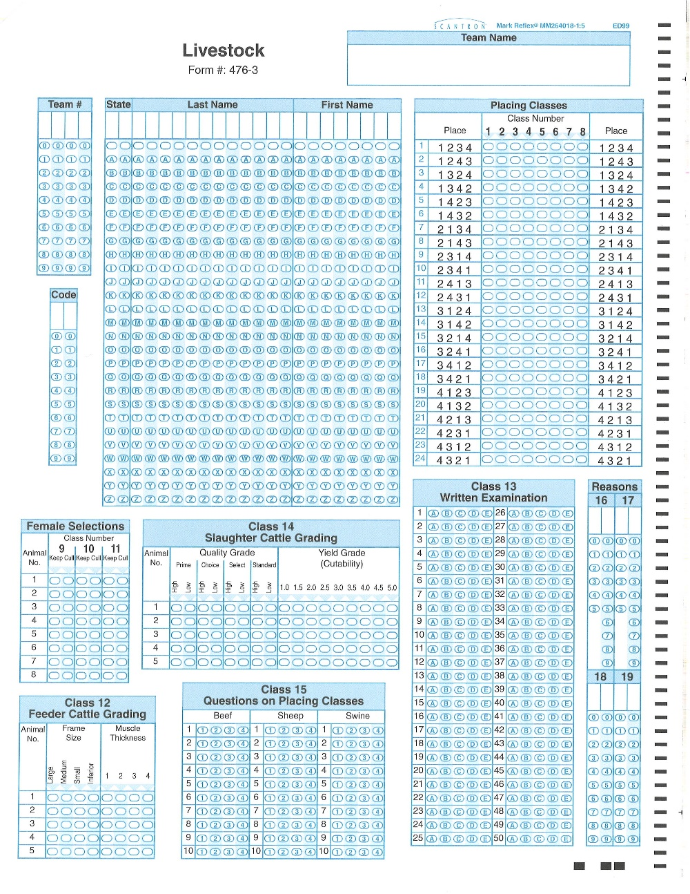
Livestock Judging Form # 476-3
County Code
Contestant Number (Team Position)
1=01
2=02
3=03
4=04
Name, First & Last
ALL MUST BE
BUBBLED IN!
Class Placings
Reasons Scores

Slide 17
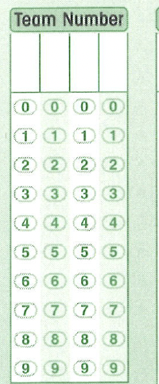
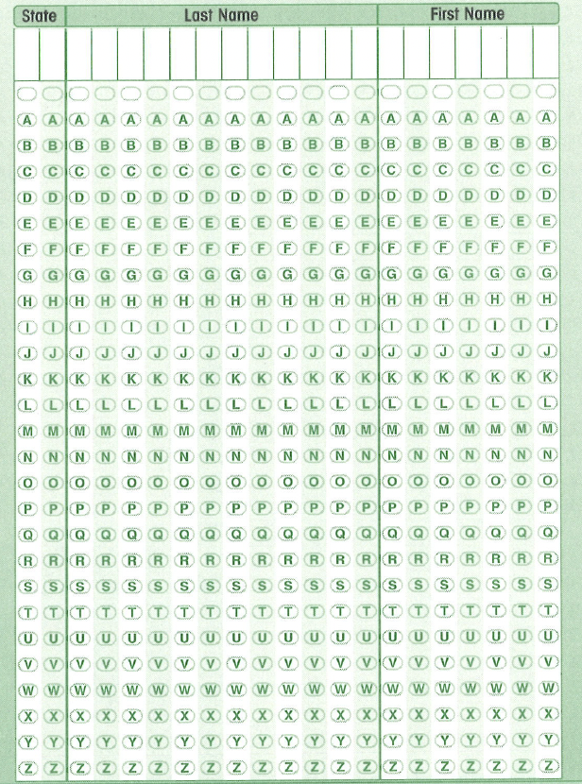
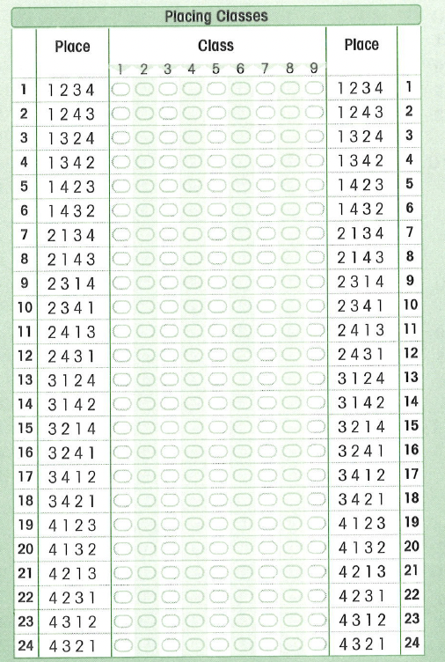
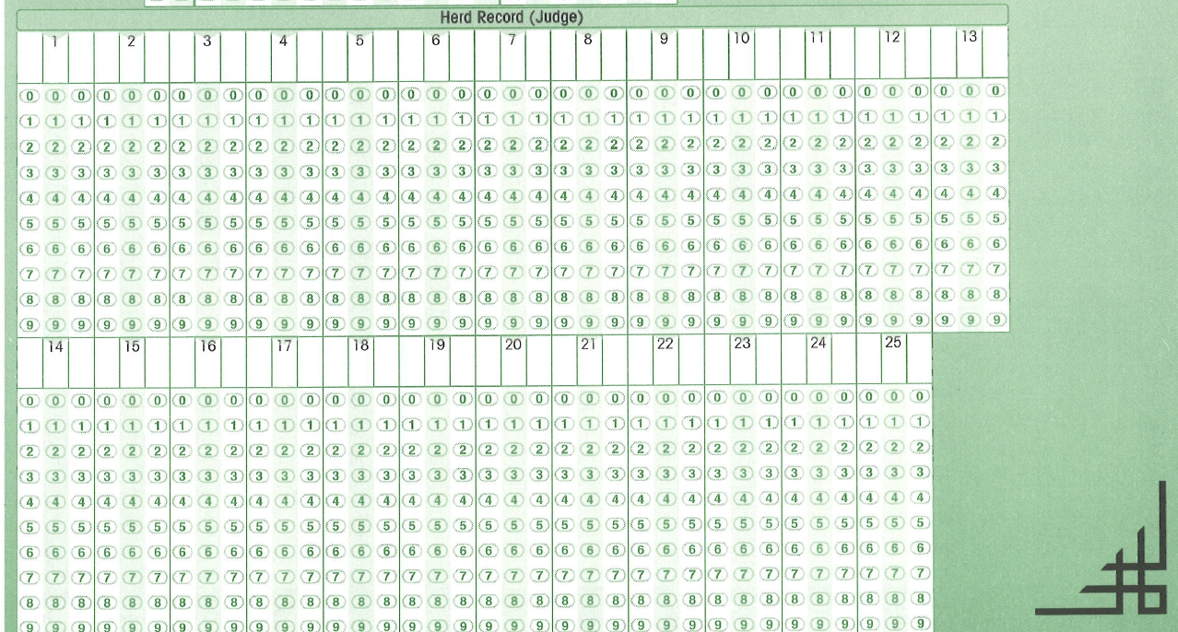
Dairy Judging CDE# 105477
County Code
Contestant Number (Team Position)
1=01
2=02
3=03
4=04
Name, First & Last
ALL MUST BE
BUBBLED IN!
Class Placings
DO NOT MARK in this section.
X

Slide 18
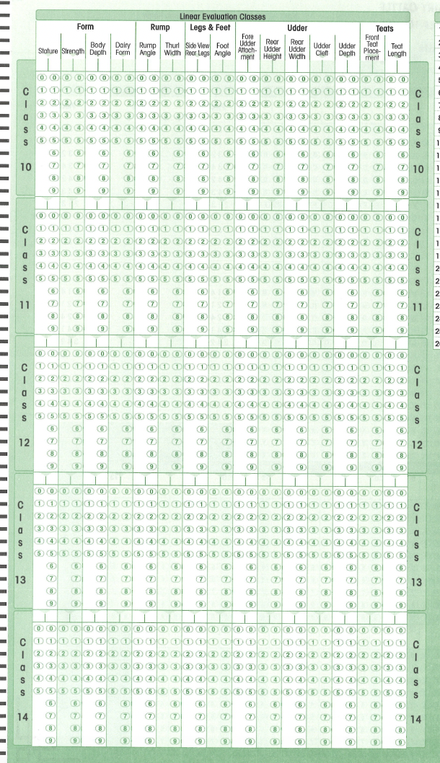
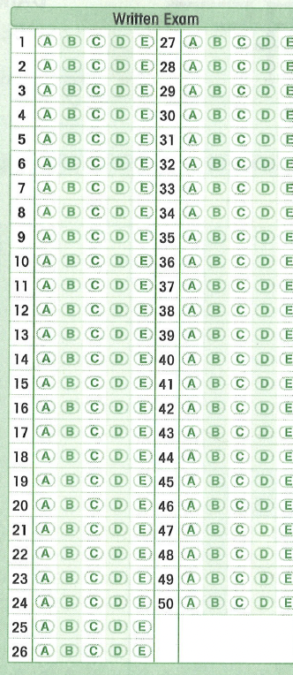
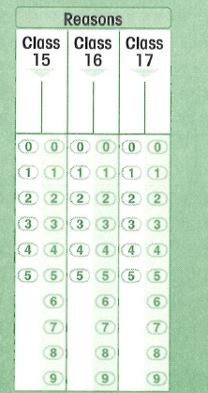
DO NOT MARK in this section.
DO NOT MARK in this section.
X
X
Reasons Scores

